Slide 1


Mini Project
Relax Mate
Make a stop here, find peace !
Candidates :
Koshika T (713323CD025)
Mohammed Afsal B (713323CD029)
Brijesh S R (713323CD006)
Kirthik Kumar S (713323CD024)
Mano Prashanth R (713323CD027)
Department Of Computer Science & Design
SNS College Of Engineering, Coimbatore

Slide 2


Introduction
In today’s fast-paced world, stress has become a widespread issue that affects individuals across all age groups, impacting mental health, productivity, and overall well-being.
Whether due to academic pressure, professional demands, or life events, stress has profound consequences on people’s emotional and physical states.
Traditional methods for stress relief, such as exercise, meditation, and therapy, are proven to be effective but may not always be feasible or accessible due to time constraints, costs, or personal preferences.

Slide 3

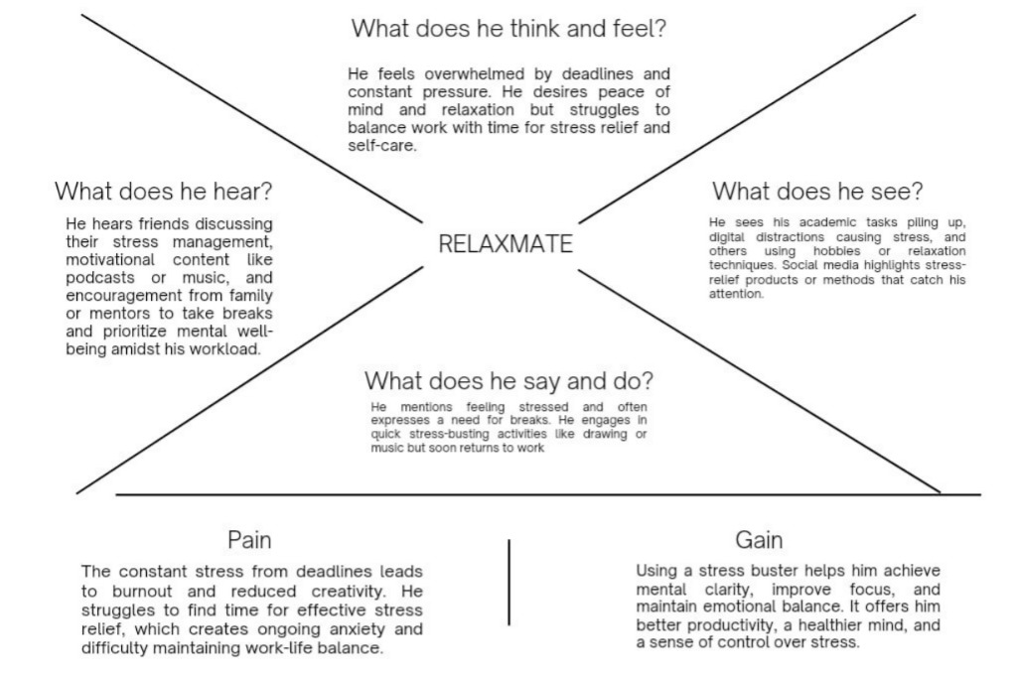
Empathy
Says
A solar tracking system adjusts solar panels to follow sun’s path, optimizing energy production. It enhances efficiency by maximizing sunlight exposure throughout the day, boosting overall renewable energy output
Thinks
A solar tracking system optimizes energy production by orienting solar panels to follow the sun’s path throughout the day, increasing efficiency and maximizing the amount of sunlight captured for power generation.
CUSTOMER
Does
A solar tracking system automatically adjusts the position of solar panels to track the sun’s movement, ensuring optimal sunlight exposure throughout the day, which enhances energy production efficiency and overall output
Feels
A solar tracking system intuitively senses the sun’s position, pivoting solar panels accordingly to harness maximum sunlight. It’s like a living organism responding to the sin’s warmth, optimizing energy absorption efficiently.

Slide 4
Abstract
The project employs a multi-faceted approach to address stress relief by creating an engaging and interactive platform.
Users begin by engaging in symmetry drawing, which fosters mindfulness through repetitive and intricate designs.
This artistic process is paired with AI-generated baby photos, triggering positive emotional responses. Additionally, soothing music and positive affirmations enhance the experience while a user-friendly interface ensures accessibility for all age groups.

Slide 5
Define
This project is designed to address the growing issue of stress experienced by individuals in various aspects of life.
By identifying the limitations of traditional stress relief methods, the project aims to create an innovative platform that combines creative expression and emotional comfort.
It seeks to empower users to take control of their well-being through engaging activities that foster mindfulness and positive emotions. By integrating features that appeal to diverse preferences, the platform provides a versatile solution.

Slide 6
Ideate
The project ideation focuses on creating a user-friendly platform that integrates multiple features for effective stress relief.
Users will engage in symmetry drawing, allowing them to express creativity while promoting mindfulness.
Complementing this activity, AI-generated baby photos will evoke positive emotions, enhancing the overall experience.
The addition of soothing music and positive affirmations aims to uplift users moods, while a simplified interface ensures accessibility for all age groups.

Slide 7
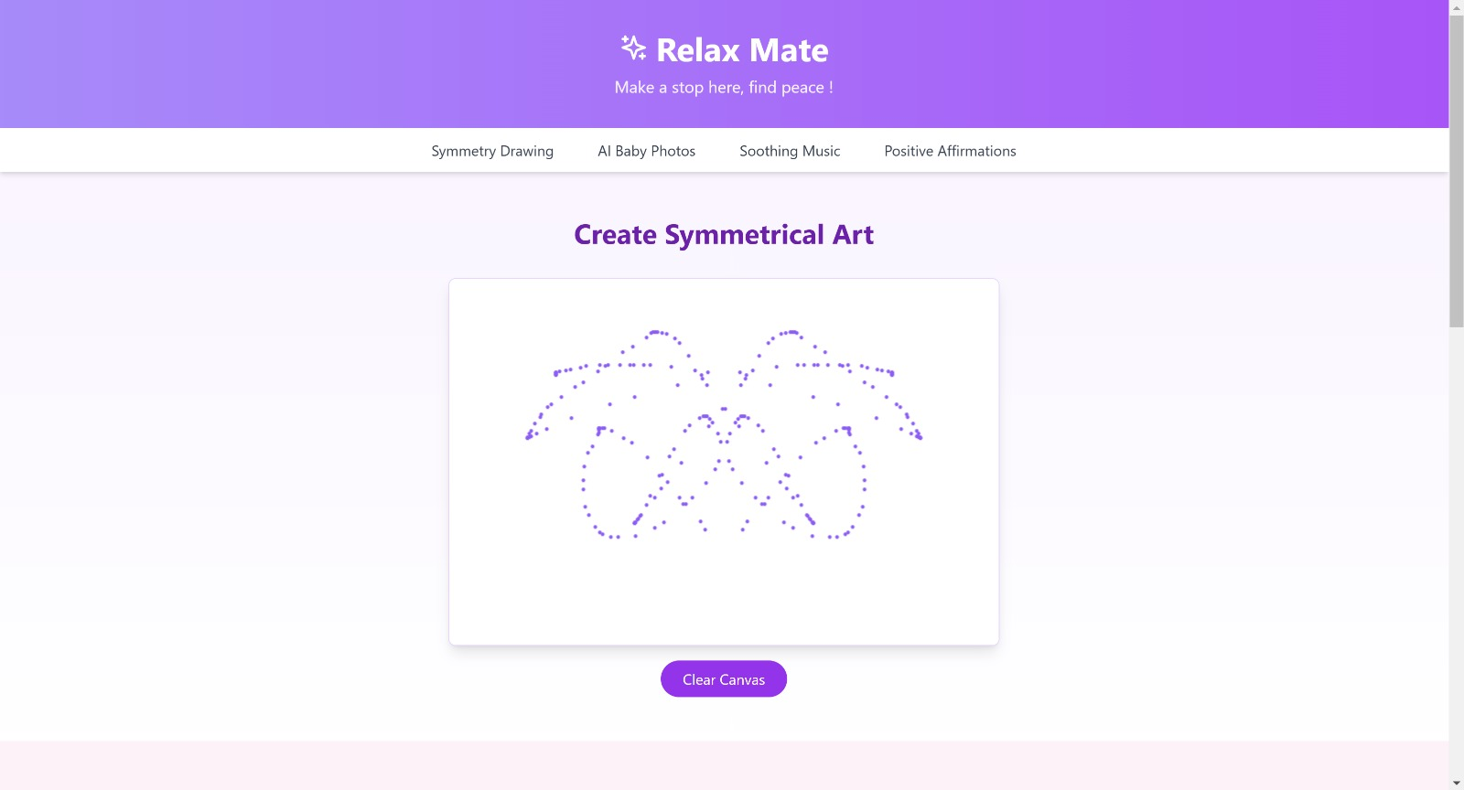
Prototype

Slide 8
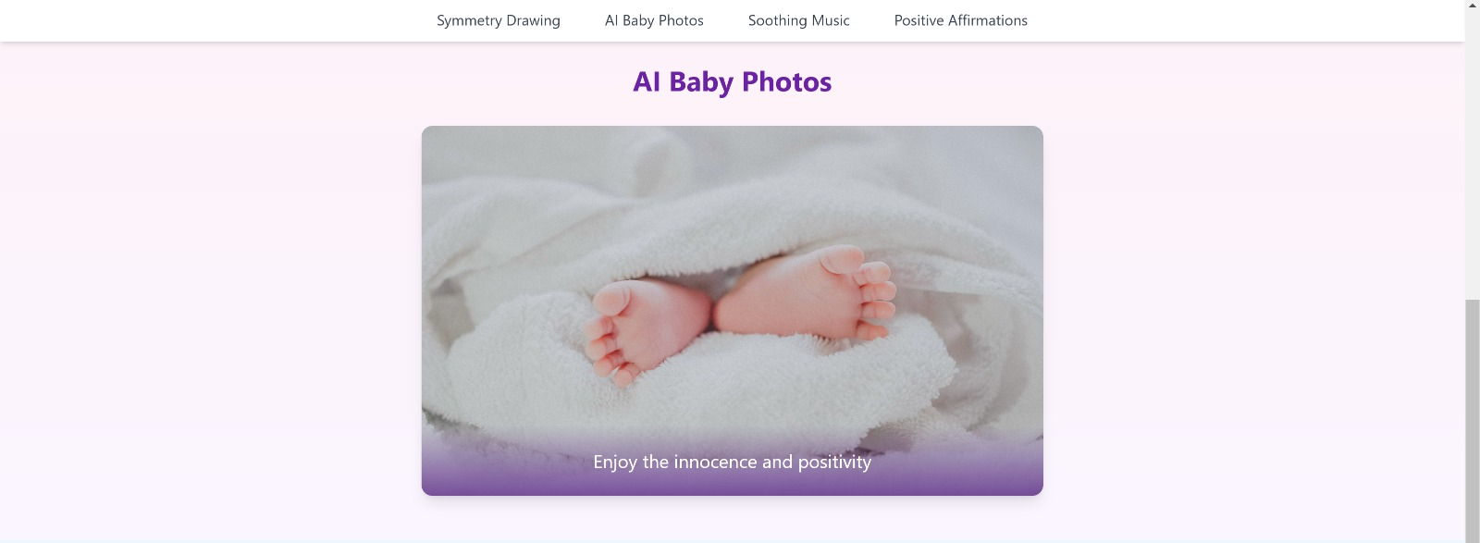
Prototype

Slide 9
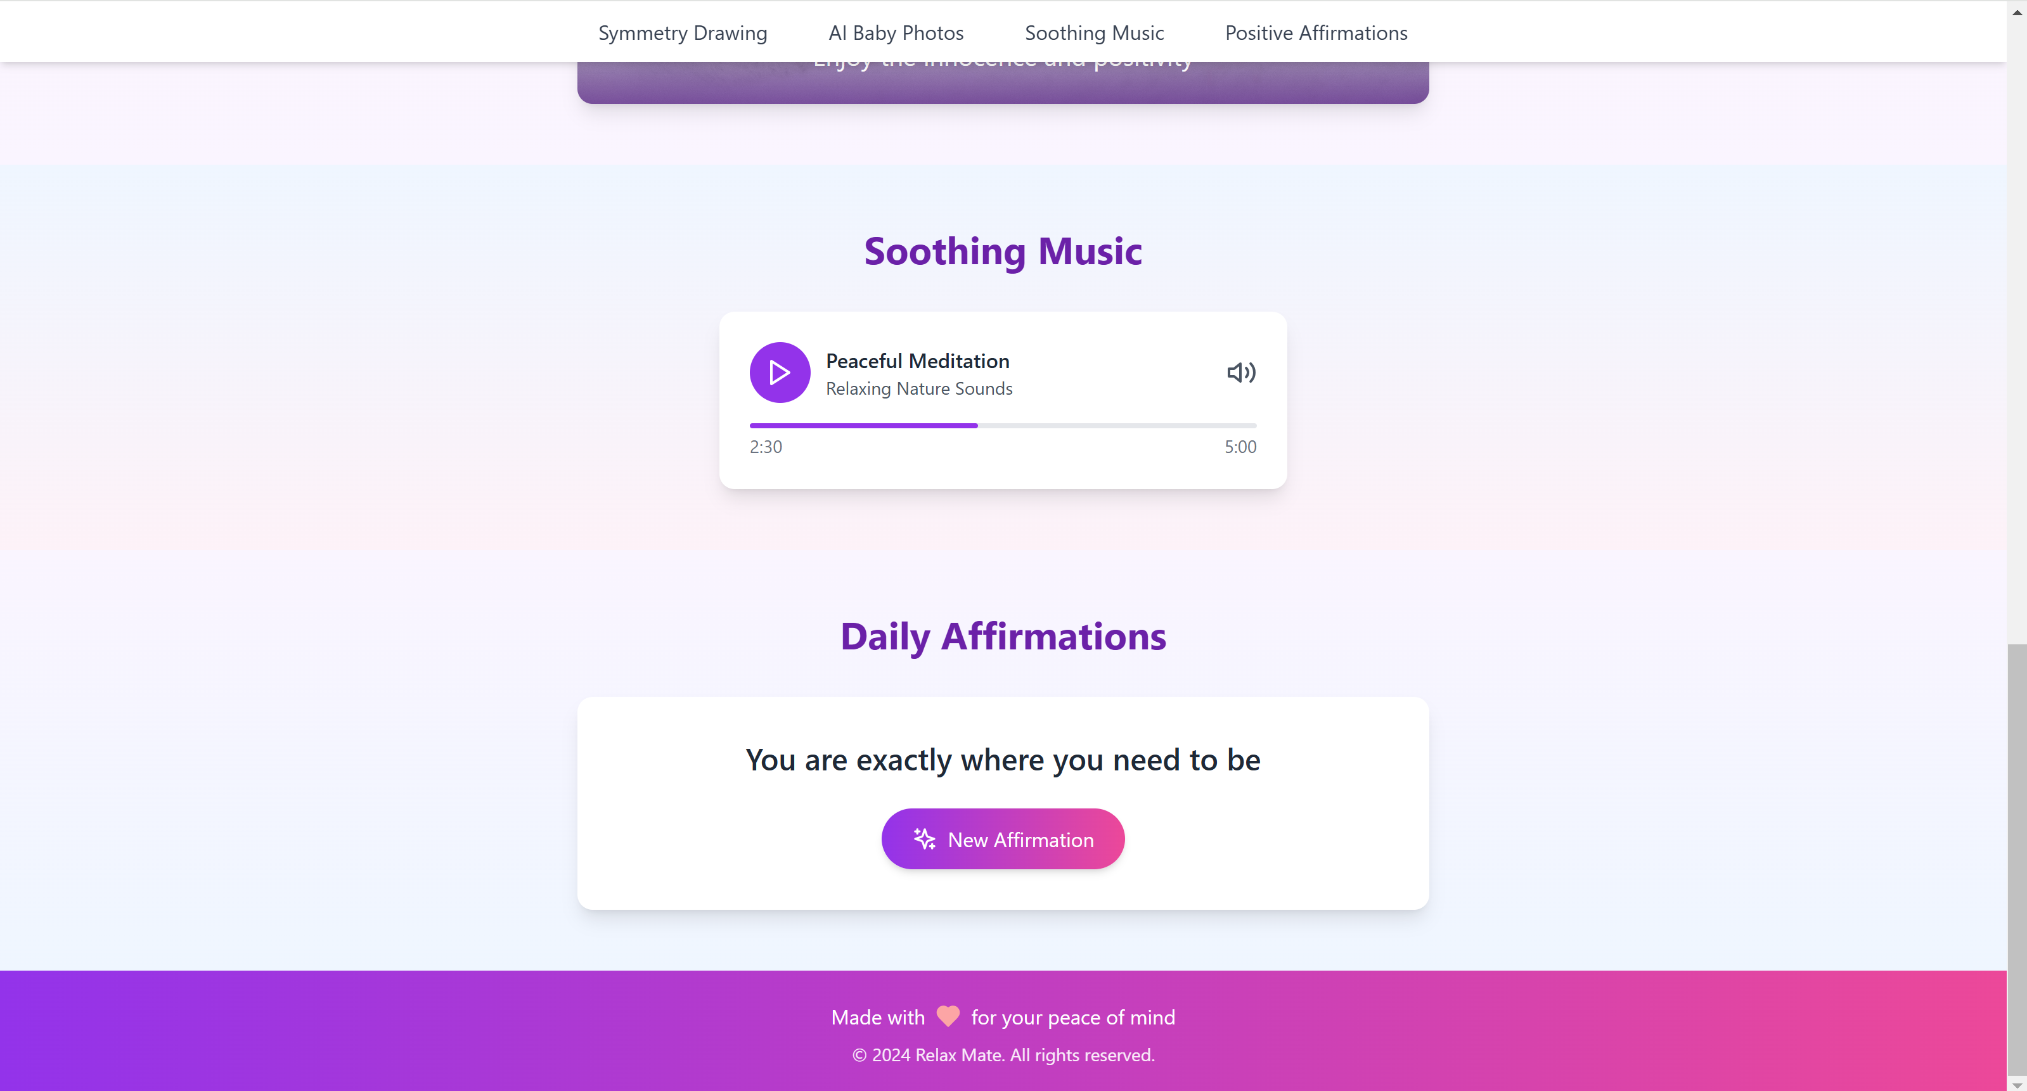
Prototype

Slide 10

Methodology
Understand user needs
Develop the platform
User Testing and Feedback
Provide Insights
Improve and Scale

Slide 11
Conclusion
The Relax Mate project effectively introduces a versatile, user-friendly platform aimed at stress relief through creative expression and emotional comfort.
By integrating features such as symmetry drawing, AI-generated baby photos, soothing music, and positive affirmations, the platform promotes mindfulness and positive emotions across diverse age groups.
This multifaceted approach to stress management not only makes the platform accessible and engaging for all but also empowers users to actively support their own well-being in a simple and enjoyable manner.

Slide 12
THANK YOU

